Slide 1
DEPARTMENT OF SURGERY
Smt. Chandaben Mohanbhai Patel Homoeopathic Medical College

Slide 2
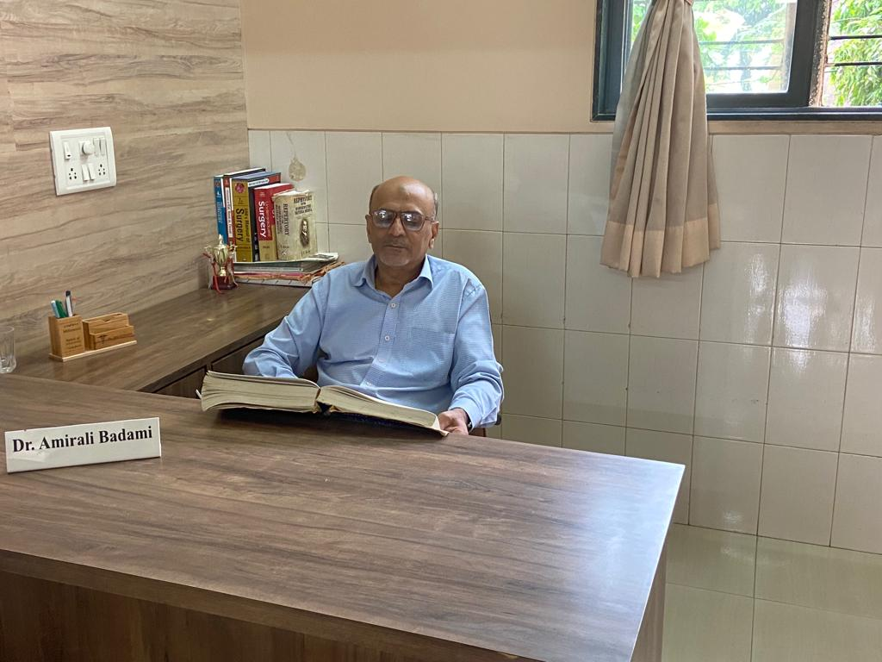

Slide 3
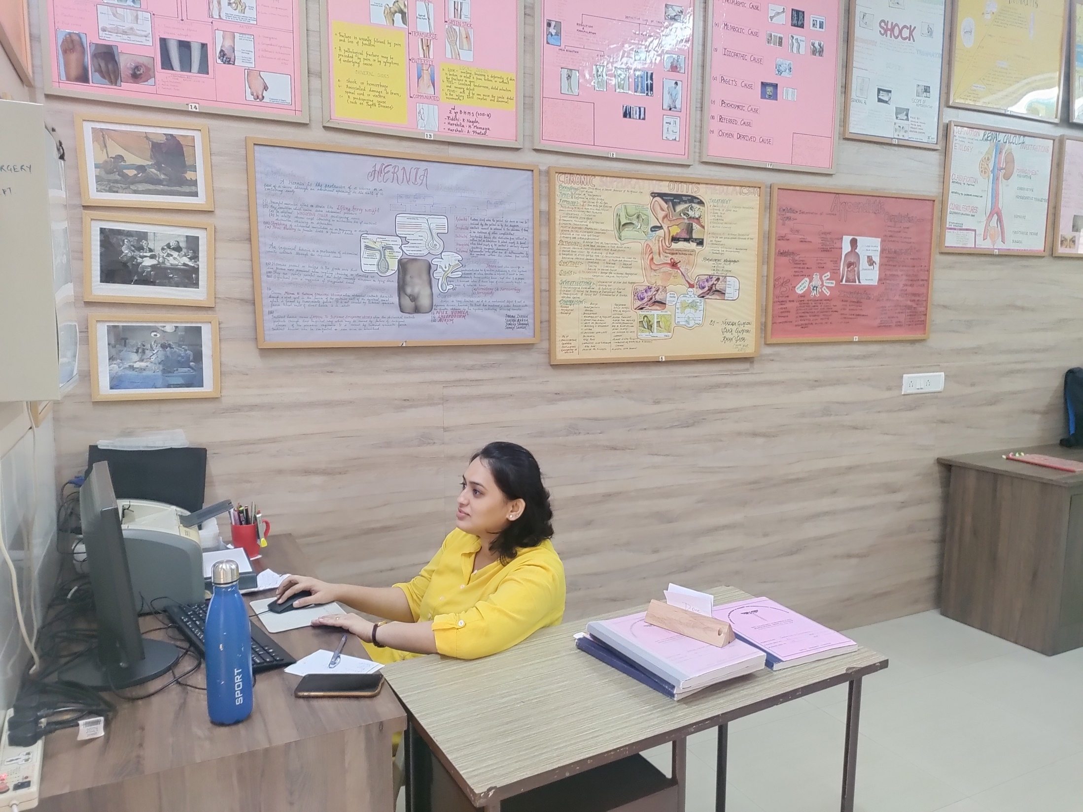

Slide 4
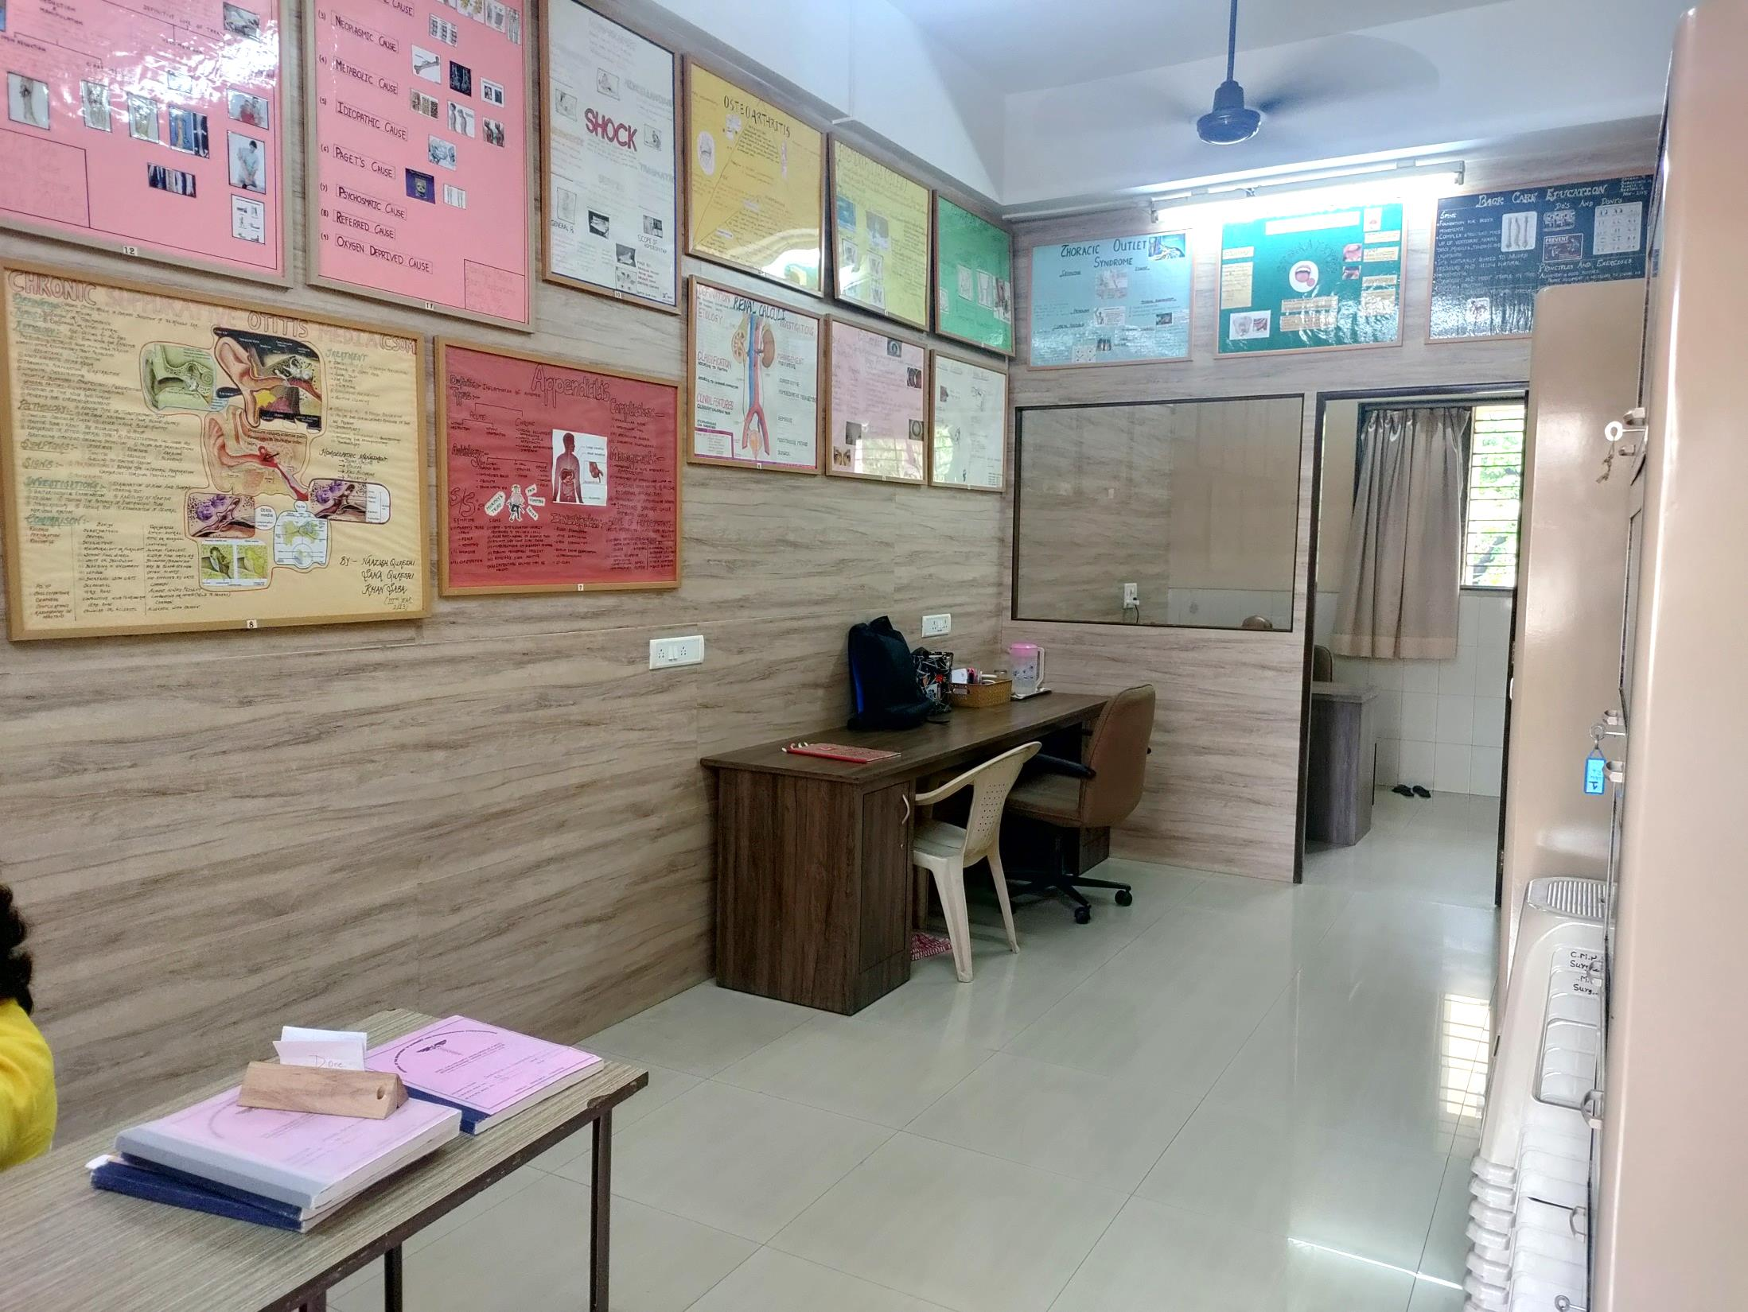

Slide 5
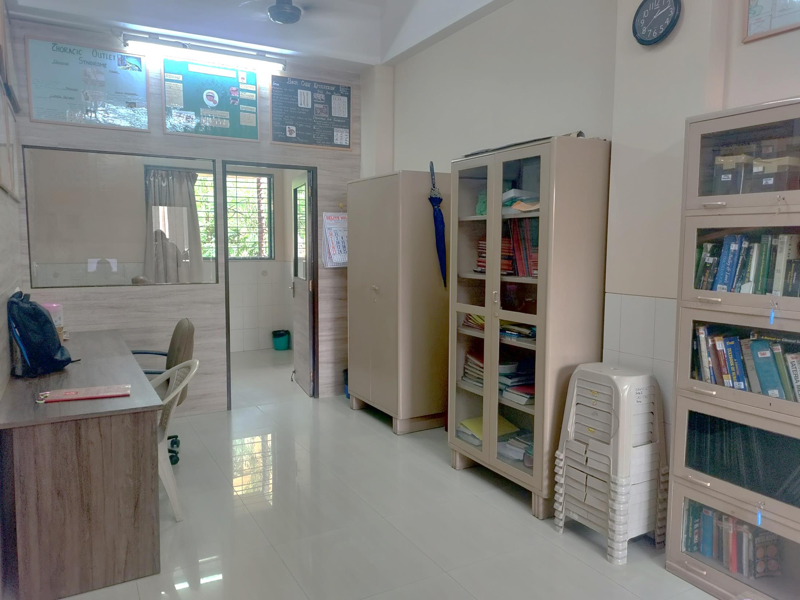

Slide 6
